Slide 1
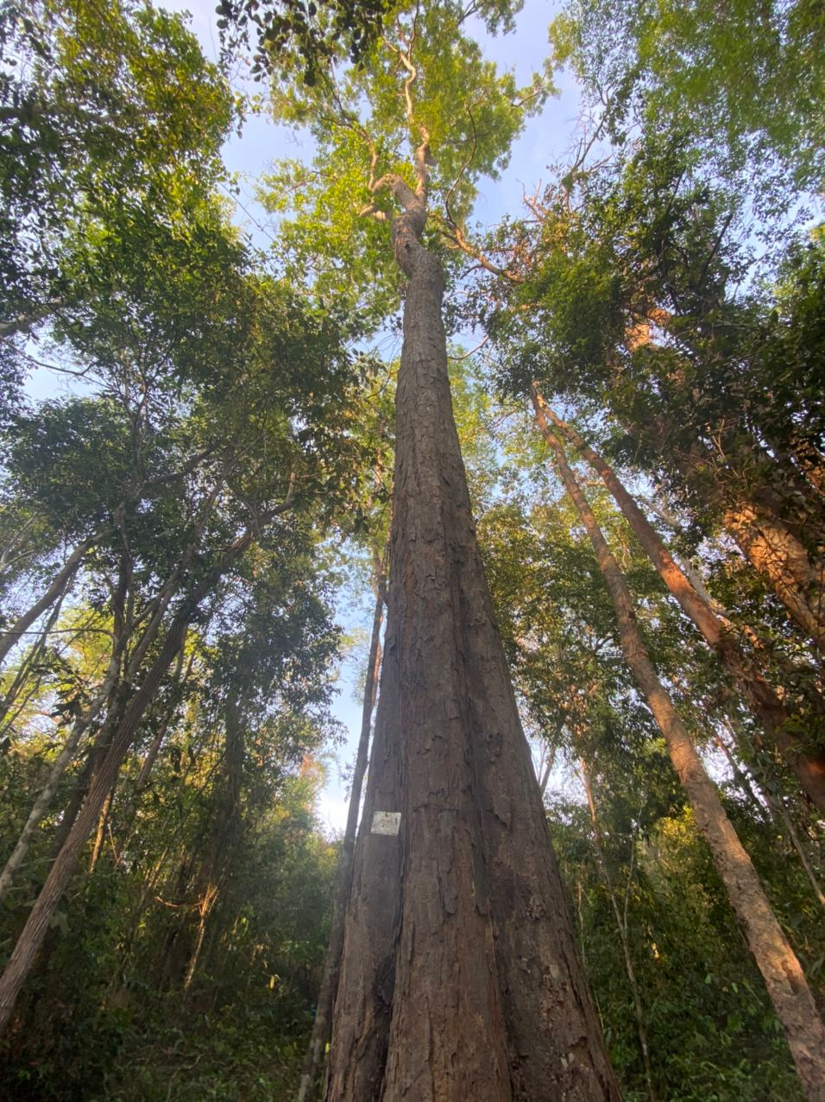
“CITES Tree Species Programme – International Closing Meeting and the 7th Meeting of Advisory Committee”
CITES CTSP Project S-568: “Integrating the Development of Guidelines and Incentives for Piloting the Establishment of Small-scale Private Dalbergia Plantations with the Determination of a Non-detriment Findings Report in Preah Vihear province in Cambodia”.
Kuala Lumpur, Malaysia 5 October 2022,
By: Chheang Dany, Say Sinly, Hort Sothea, Pang Phanit, Lao Sethaphal and You Viy

Slide 2
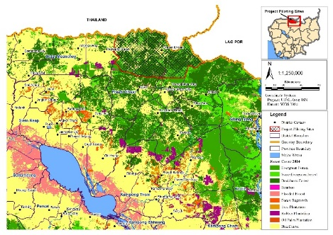
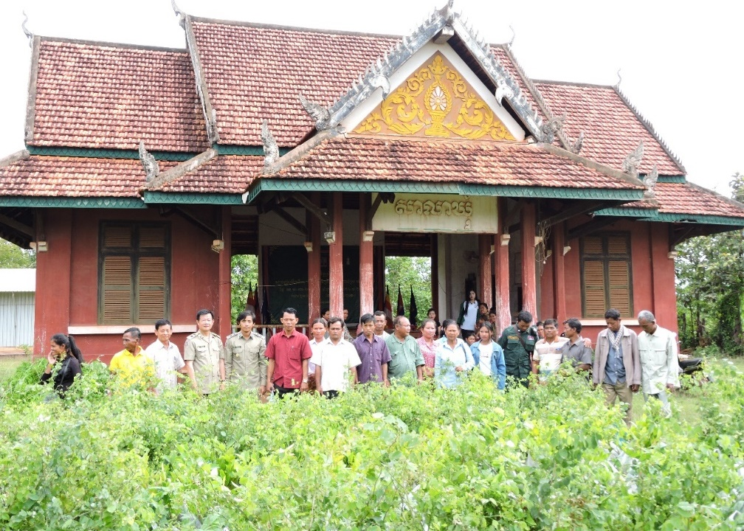
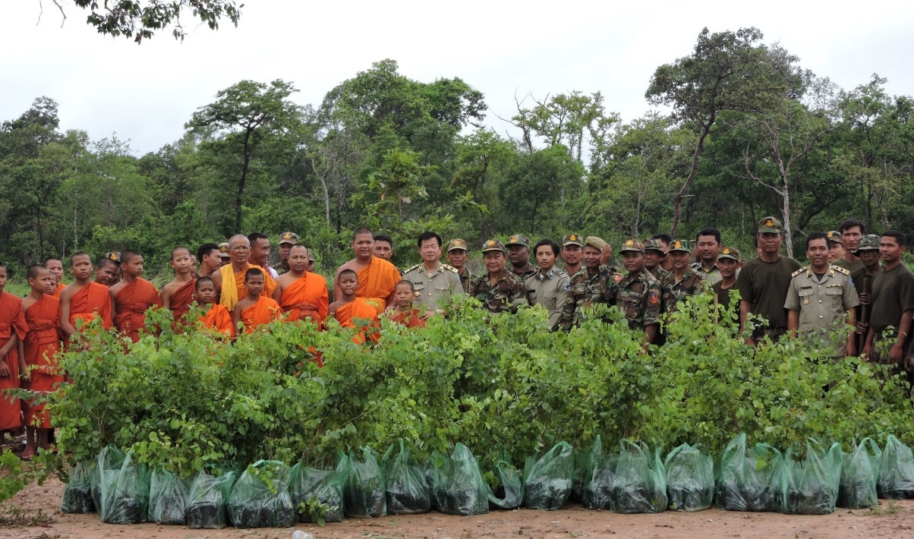
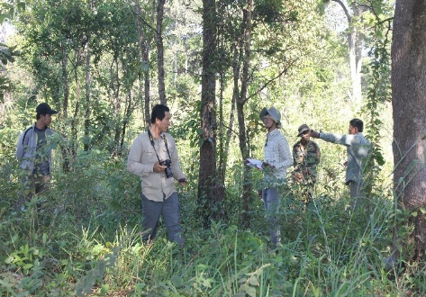
Dalbergia Cochichinensis Plantation
Green Investment - Challenges and Opportunities
Project Identification:
Project Title: Integrating the Development of Guidelines and Incentives for Piloting the Establishment of Small-scale Private Dalbergia Plantations with the Determination of a Non-detriment Findings Report in Preah Vihear province in Cambodia.
Project Goal: The Goal of the project is to ensure the survival and sustainable management and expand the area of D. cochinchinensis and D. oliveri in Cambodia.
Project Objective: The Objective of the project is to develop a non-detriment findings report on D. cochinchinensis and D. oliveri in Preah Vihear province and institutionalize an enabling environment to support the establishment of small-scale private plantations of the species.
Total Budget: USD 173,622.50 (CITES Contribution: USD 149,800.00, Gov’t and Other Sources: USD 23,822.50)
Period Covered: The period covered by this report is 15 August 2019 to 19 July 2022.

Slide 3
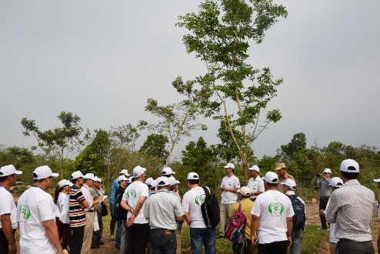
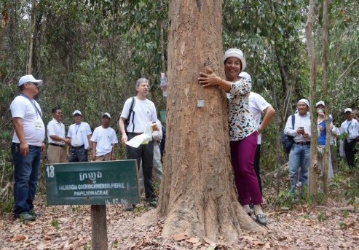
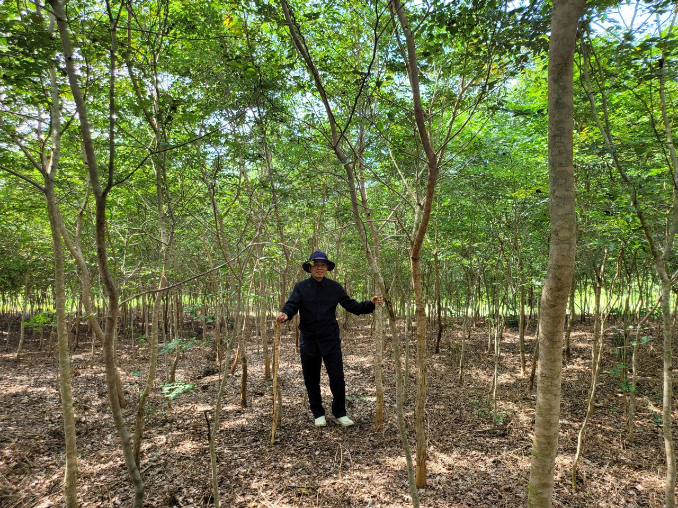
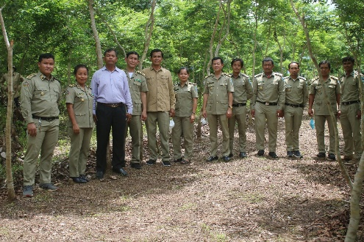
Dalbergia Cochichinensis Plantation
Green Investment - Challenges and Opportunities
Dalbergia Cochinchinensis Pierre
Taxonomy and Commercial Grade
Cambodian name : Kra-gnourng
Scientific name : Dalbergia cochinchinensis Pierre.
Syn : Dalbergia cambodiana Pierre.
Family : Leguminosae
Sub-family : Papilionoideae
Commercial Grade-Cambodia: Luxury
IUCN Classification : VU A1CD
CITES : Appendix II
Distribution and Habitat: Native to Indo-China and adjacent countries. Scattered trees form small populations in dense tropical evergreen forest, on fertile soil (CTSP, 2001), mixed deciduous forests up to 500m a.s.l (Dy Phon, 2000) and lowland forests with uniform rainfall (1200-1650mm per year). It is light demanding, drought tolerant and with no special demands for soil conditions (DFSC, 2000).
Botanical Description: Dalbergia cochinchinensis Pierre is a large evergreen tree species, 25 – 30m high and generally 60cm in diameter. The species is easily recognized through its light yellow bark, sometimes multiple stems and branches. It has red coloured wood, beautiful veins; it is hard and durable with a density of 1.0-1.8, and resistant to termites. Pinnate leaves have 7 – 9 leaflets, where the last leaflet is the biggest (CTSP, 2001). The species regenerates naturally and coppices well, but the growth rate is rather slow (DFSC, 2000).

Slide 4
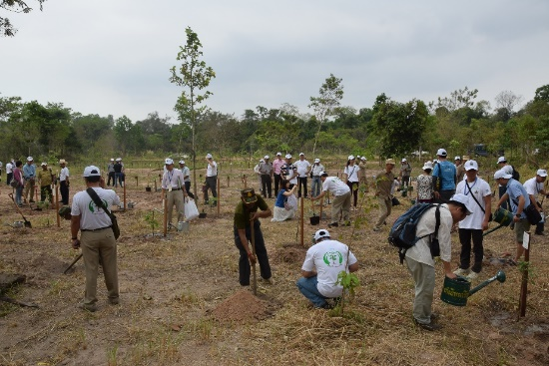
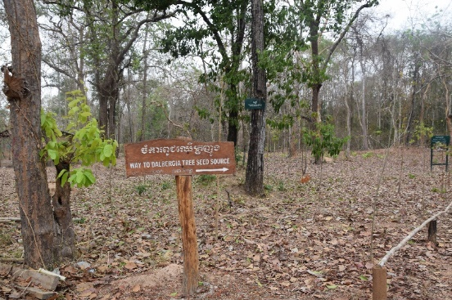
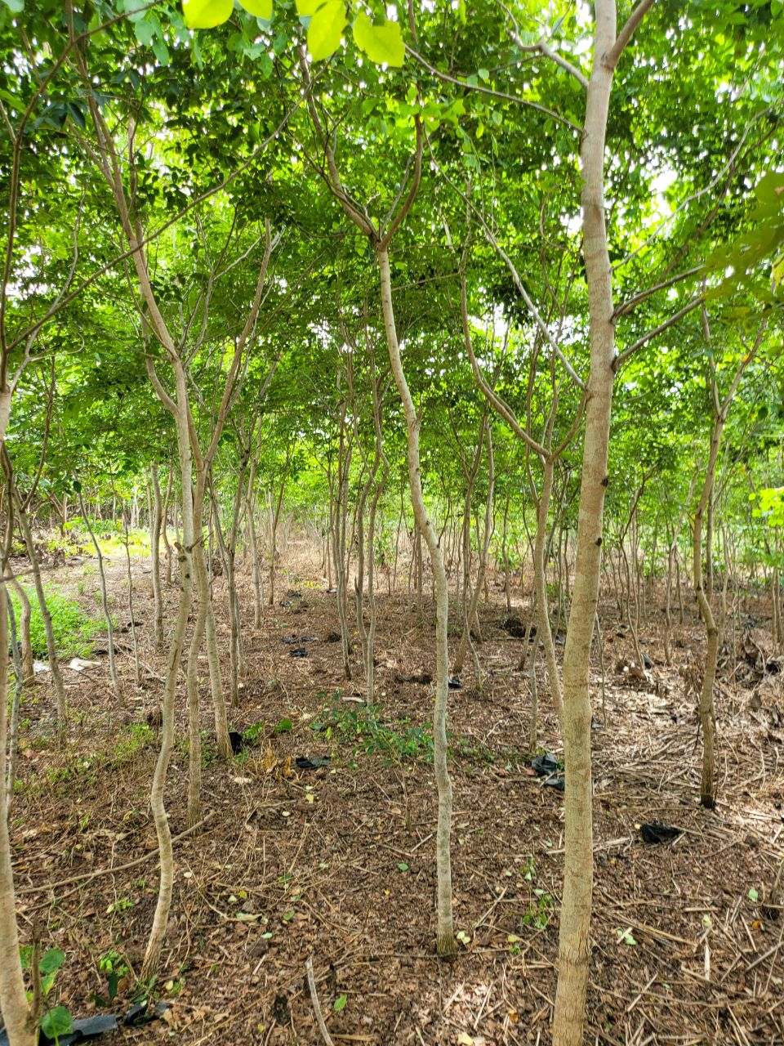
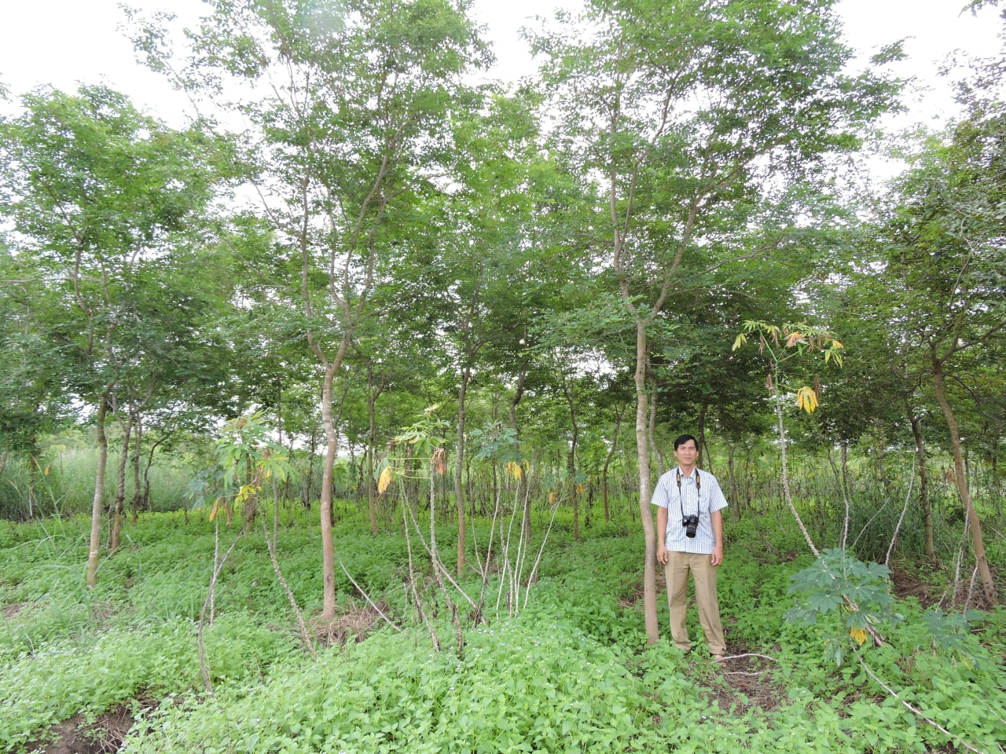
Dalbergia Cochinchinensis Plantation
Green Investment - Challenges and Opportunities
Dalbergia Cochinnesis Pierre
Planting Option:
Backyard or around houses
Small to big scale plantation
Natural Growth is slow,
Enhancement Plantation (well managed)
Currently: ~ 5.75 millions stand trees (age of 2-10years, 2.75- 15 meter high) of planted Dalbergia Cochinnesis Pierre in Cambodia
High Market Demand
Can plant mostly everywhere in Cambodia

Slide 5
Dalbergia Cochinchinensis Plantation
Green Investment - Challenges and Opportunities
Cost and Benefit: Dalbergia Cochinchinensis Plantation
NPV & IRR | 30Y | 25Y | 20Y | 15Y | 10Y
NPV (i = 6%) | 551,714.99 | 195,369.20 | 166,817.85 | 149,796.77 | 108,280.56
NPV (i = 8%) | 349,643.62 | 136,136.16 | 121,680.92 | 115,045.96 | 89,381.97
NPV (i = 10%) | 225,902.13 | 96,297.99 | 89,516.24 | 88,736.46 | 73,954.10
NPV (i = 12%) | 148,711.09 | 69,057.12 | 66,359.00 | 68,698.57 | 61,314.17
IRR (%) | 40.56% | 40.02% | 40.60% | 43.65% | 54.68%
Dalbergia Cochinchinensis Pierre
Commercial Grade and Value
Value: 1500-3000 $ m³, depended on quality, diameter & length

Slide 6
Results and Outputs
Systematic Survey Report of Dalbergia cochinchinensis and Dalbergia oliveri for Piloting Assessment on Sustainable Genetic Conservation in Choam Ksant District, Preah Vihear Province”
A “Review of the taxonomy, biology, ecology, and the status, trend, and population structure of D. cochinchinensis and D. oliveri in Choam Ksant District, Preah Vihear Province, Cambodia”
An assessment report on “Conservation Status, Management Practices, and Harvest Monitoring of Dalbergia cochinchinensis and Dalbergia oliveri Monitoring of Dalbergia cochinchinensis and Dalbergia oliveri in the Choam Ksant District, Preah Vihear Province”
A report entitled “CITES Non-detriment Findings Report on Dalbergia cochinchinensis and Dalbergia oliveri in the Choam Ksant District, Preah Vihear Province”
A report on the “Guidelines on Private Forest Registration in Cambodia” (Khmer language with English Executive Summary)
A “Report on National Extension and Consultation Workshop on Rules and Guidelines for Private Forest Plantation Registration in Cambodia, 26-27 November 2021, Phnom Penh, Cambodia
A “Report on the Virtual Training Workshop on the CITES Non-detriment Findings on D. cochinchinensis and D. oliveri and the Economic Analysis and Comparative Advantage of Plantations of D. cochinchinensis”.
A report on the “Guidelines and Incentives to Encourage the Establishment of Private Plantations of Dalbergia cochinchinensis and Dalbergia oliveri in Cambodia” submitted to the CITES Secretariat on 9 June 2022 and was uploaded to the CTSP website.
A 20 – minutes (3 minutes) project highlight for CITES CTSP Websites .

Slide 7
Systematic Survey Report of
Dalbergia cochinchinensis and Dalbergia oliveri
A “Systematic Survey Report of Dalbergia cochinchinensis and Dalbergia oliveri for Piloting Assessment on Sustainable Genetic Conservation in Choam Ksant District, Preah Vihear Province” submitted to the CITES Secretariat on 15 April 2021 and was uploaded to the CTSP website.
Link: https://cites-tsp.org/2021/07/26/systematic-survey-report-of-dalbergia-cochinchinensis-and-dalbergia-oliveri-for-piloting-assessment-on-sustainable-genetic-conservation-in-choam-ksant-district-preah-vihear-province/

Slide 8
Review of the taxonomy, biology, ecology, and the status, trend, and population structure of D. cochinchinensis and D. oliveri
A report on a “Review of the taxonomy, biology, ecology, and the status, trend, and population structure of D. cochinchinensis and D. oliveri in Choam Ksant District, Preah Vihear Province, Cambodia” submitted to the CITES Secretariat on 15 April 2021 and was uploaded to the CTSP website.
Link: https://cites-tsp.org/2021/07/26/review-of-the-taxonomy-biology-ecology-and-the-status-trend-and-population-structure-of-d-cochinchinensis-and-d-oliveri-in-choam-ksant-district-preah-vihear-province-cambodia/

Slide 9
Conservation Status, Management Practices, and Harvest Monitoring of Dalbergia cochinchinensis and Dalbergia oliveri
An assessment report on “Conservation Status, Management Practices, and Harvest Monitoring of Dalbergia cochinchinensis and Dalbergia oliveri Monitoring of Dalbergia cochinchinensis and Dalbergia oliveri in the Choam Ksant District, Preah Vihear Province” submitted to the CITES Secretariat on 22 July 2021 and was uploaded to the CTSP website
Link: https://cites-tsp.org/2021/07/26/assessment-report-on-the-conservation-status-management-practices-and-harvest-monitoring-of-dalbergia-cochinchinensis-and-dalbergia-oliveri-in-the-choam-ksant-district-preah-vihear-province/

Slide 10
CITES Non-detriment Findings Report on
Dalbergia cochinchinensis and Dalbergia oliveri
A report entitled “CITES Non-detriment Findings Report on Dalbergia cochinchinensis and Dalbergia oliveri in the Choam Ksant District, Preah Vihear Province” submitted to the CITES Secretariat on 23 September 2021 and was uploaded to the CTSP website
Link: https://cites-tsp.org/2021/10/05/cites-non-detriment-findings-report-on-dalbergia-cochinchinensis-and-dalbergia-oliveri-in-the-choam-ksant-district-preah-vihear-province/

Slide 11
Guidelines on Private Forest Registration in Cambodia
A report on the “Guidelines on Private Forest Registration in Cambodia” (Khmer language with English Executive Summary submitted to the CITES Secretariat on 21 January 2022 and was uploaded to the CTSP website.
Link: https://cites-tsp.org/2022/01/24/guidelines-on-private-forest-registration-in-cambodia/

Slide 12
Report on National Extension and Consultation Workshop on Rules and Guidelines for Private Forest Plantation Registration in Cambodia
A “Report on National Extension and Consultation Workshop on Rules and Guidelines for Private Forest Plantation Registration in Cambodia, 26-27 November 2021, Phnom Penh, Cambodia” submitted to the CITES Secretariat on 1 October 2021 and was uploaded to the CTSP website
Link: https://cites-tsp.org/2021/10/05/report-on-national-extension-and-consultation-workshop-on-rules-and-guidelines-for-private-forest-plantation-registration-in-cambodia/

Slide 13
Report on the Virtual Training Workshop on the CITES Non-detriment Findings on D. cochinchinensis and D. oliveri
A “Report on the Virtual Training Workshop on the CITES Non-detriment Findings on D. cochinchinensis and D. oliveri and the Economic Analysis and Comparative Advantage of Plantations of D. cochinchinensis” submitted to the CITES Secretariat on 5 April 2022 and was uploaded to the CTSP website
Link: https://cites-tsp.org/2022/04/05/report-on-the-virtual-training-workshop-on-the-cites-non-detriment-findings-report-on-d-cochinchinensis-and-d-oliveri-and-the-economic-analysis-and-comparative-advantage-of-plantations-of-d-cochinc/

Slide 14
Guidelines and Incentives to Encourage the Establishment of Private Plantations of Dalbergia cochinchinensis and Dalbergia oliveri in Cambodia
A report on the “Guidelines and Incentives to Encourage the Establishment of Private Plantations of Dalbergia cochinchinensis and Dalbergia oliveri in Cambodia” submitted to the CITES Secretariat on 9 June 2022 and was uploaded to the CTSP website
Link: https://cites-tsp.org/wp-content/uploads/2022/06/KH-Guidelines-and-Incentives-for-Dalbergia-cochinchinensis-and-D.-oliveri-Estabishment_compressed.pdf

Slide 15
A 20-minute (or 3 minutes) video for CITES CTSP
A 20-minute video was produced and submitted to the CITES Secretariat on 23 November 2021

Slide 16
Analysis of Activities Implementation
Main implementation challenges
Organizing the business-related training for private sector entities and small-scale farmers to participate in the establishment of small-scale private plantations of D. cochinchinensis and D. oliveri and a workshop to disseminate the NDF of D. cochinchinensis and D. oliveri in the Choam Ksant management district in Preah Vihear province had to be rescheduled because of the Covid-19 pandemic.
While the implementation of the two activities was delayed due to the Covid-19 pandemic, the two activities were successfully organized virtually in November 2021.

Slide 17
Analysis of Activities Implementation
Lessons learned towards achieving the project objectives
Local communities and public institutions in the Choam Ksant management district participated actively in the planting of D. cochinchinensis and demonstrated their willingness to plant the CITES-listed tree species on their farms and in their home gardens.
Even though the implementation of the project was delayed on more than one occasion because of the impacts of the Covid-19 pandemic, the outputs and activities of the project were successfully completed.
Famers and representatives of the private sector who own plantations of D. cochinchinensis in Cambodia had expressed their willingness to register their plantations.
Others (please specify)
In an effort to disseminate information about the activities and outputs of the project and encourage individuals and legal entities to plant CITES-listed tree species, a short video describing the activities of the project and its achievements was produced. Its production was intended to contribute to the development of a policy framework that encourages the planting and restoration of CITES-listed trees and the implementation of other related conventions.

Slide 18
CONCLUSSIONS
The progress toward the achievement of the project's Specific Objective had been successful with all of the activities completed even though the implementation of the project experienced various delays because of the impacts of the Covid-19 pandemic. The project’s three outputs were also successfully achieved where two of the main outputs were the endorsement by the Forestry Administration of the guidelines and incentives for the establishment of small-scale private forest plantations in Cambodia and the Non-Detriment Findings report on D. cochinchinensis and D. oliveri in the Choam Ksant management district.
Eight reports were prepared and submitted to the CITES Secretariat and were uploaded to the CTSP website. A 20-minute video associated with D. cochinchinensis and D. oliveri in the Choam Ksant management district, Preah Vihear province of Cambodia was also produced to share experiences with other parties to the CITES convention with regard to the management, conservation and restoration of D.cochinchinensis and D. oliveri. In addition, the distribution of 48,940 seedlings of D. cochinchinensis in the Choam Ksant district would enhance the restoration of CITES-listed tree species and contribute to the genetic conservation of D. cochinchinensis, as well as an important seed source. These achievements would not only contribute to the conservation and management of D. cochinchinensis and D. oliveri, but also to other international conventions in mitigating climate change and enhancing the green cover of our planet.
The positive impact of the endorsement by the Forestry Administration of the “Guidelines on Private Forest Registration in Cambodia” and the guidelines and incentives for the establishment of small-scale private forest plantations in Cambodia had resulted in approximately 360 ha of private forest plantations, including a large number of D. cochinchinensis plantations, registered with the Forestry Administration. It is expected that more applications will be submitted requesting the registration of private forest plantations.
The total expenditures incurred using the CITES contributions during the reporting period from 15 August 2019 to 19 July 2022 was USD 149,800.00 as compared to the total amount of USD 142,310.00 received from the CITES Secretariat. As such, the total CITES contributions to the project of USD 149,800.00 had, in fact, been fully spent at the end of 31 December 2021. During the same reporting period, the total expenditures incurred from government in-kind contributions and from other sources was USD 23,822.50

Slide 19
SUGGESTIONS AND RECOMMENDATIONS
Mobilize financial resources to plant more CITES’s Tree Species listed as part of Global Land Scape Restoration and One Trillion Tree Initiative (The 2020 World Economic Forum, held in Davos, announced the creation of the One Trillion Tree initiative platform for governments, businesses, and civil society to provide support to the UN Decade on Ecosystem Restoration (2020–2030), led by UNEP and FAO. Forum participant Donald Trump, then-president of the United States, announced that the government of the U.S. would commit to the initiative)
Need financial support for project related to developing local/national Guidelines/ Regulations/ Assessment on Legal Acquisition Finding (LAF) and Non- Detrimental Finding (NDF), Trade Traceability, Green Supply Chain and Compliance on CITES’s Tree Species listed.
CITES CTSP shall continue

Slide 20
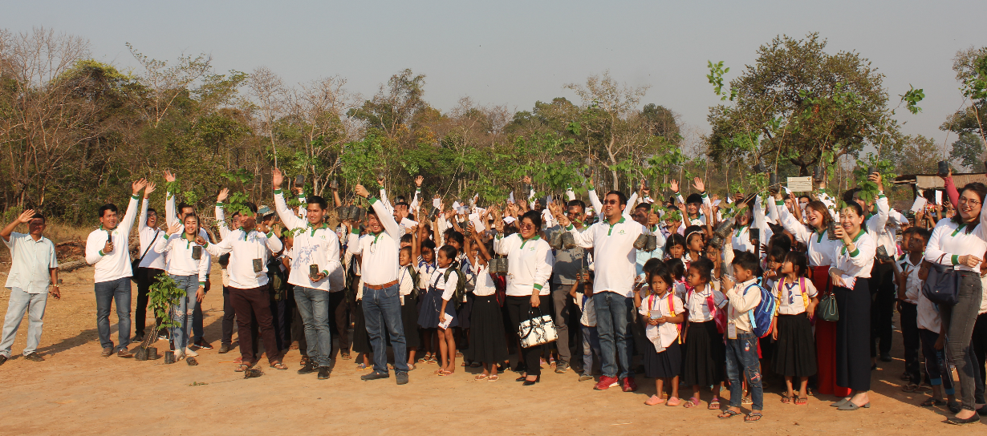
Thank you for your attention!
Special Thanks to:
EU, CITES Secretariat, CTSP, FA, AFoCO, ITTO and all Project Contributors
For Further Contact: wpo@online.com.kh; saysinlyrua@gmail.com; sotheahort@gmail.com

