Slide 1




Conservation and Sustainable Management of Osyris lanceolata for Economic Development in East Africa
By
Beatrice Khayota, Solomon Kyalo, James Mwamondenyi, Joseph Otieno, Agnes Lusweti
Bernard Kamondo and Issa Katwesige
Presented at
CITES Tree Species Programme Closure Meeting
Kualar Lumpur, Malaysia
5-7 October 2022

Slide 2
Introduction
Title: Conservation and Sustainable Management of Osyris lanceolata for Economic Development in East Africa
Implementing Agency: National Museums of Kenya
Project Leader:
  Coordinator: Beatrice Khayota
  Kenya James Mwamondenyi Mwangombe
  Uganda: Issa Katwesige
  Tanzania: Joseph Otieno
CITES Management Authority Focal person:
  Kenya: Solomon Kyalo
  Uganda: James Lutalo
  Tanzania: Director of Wildlife

Slide 3
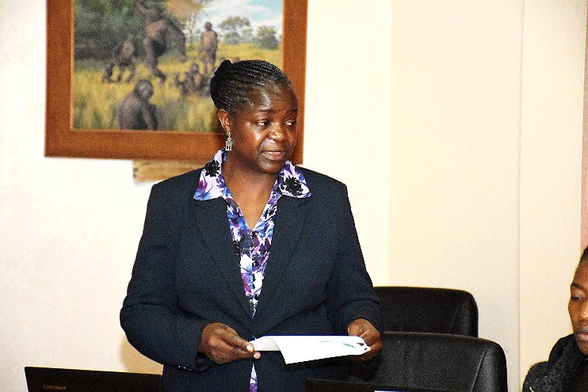
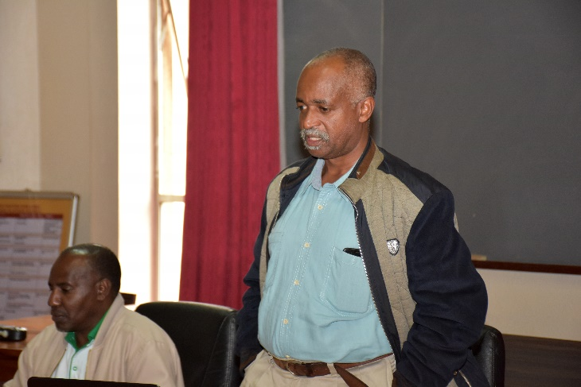
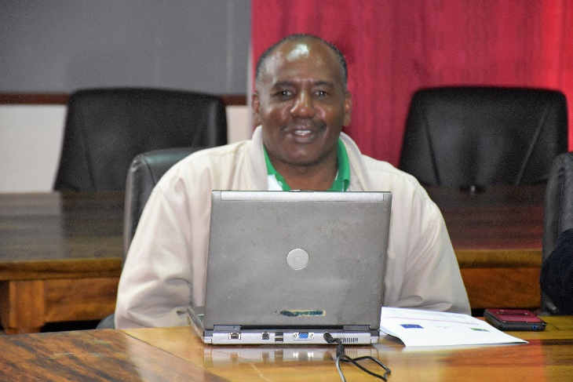
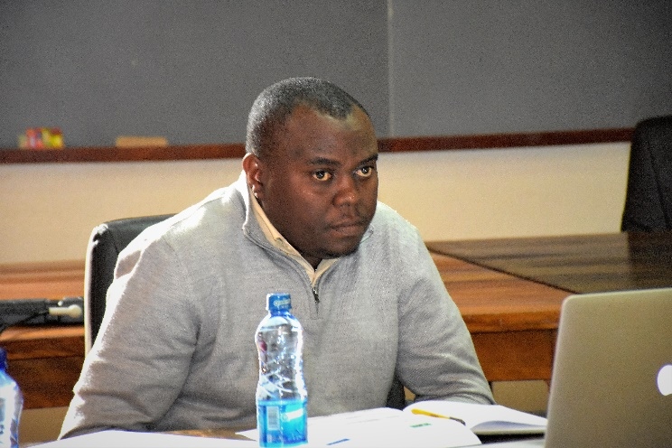
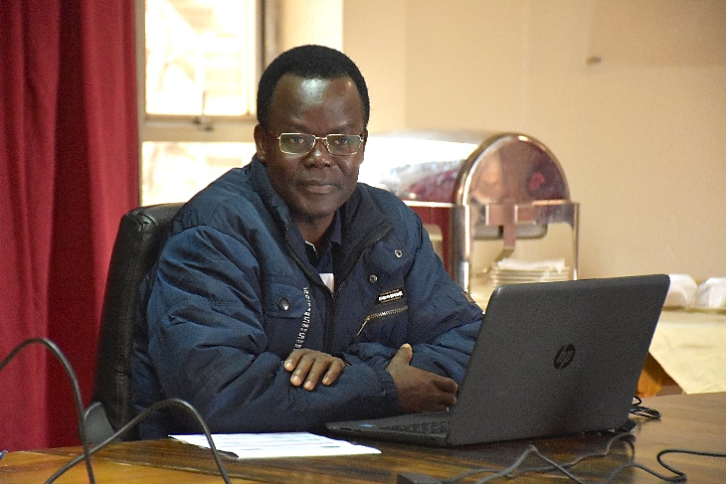
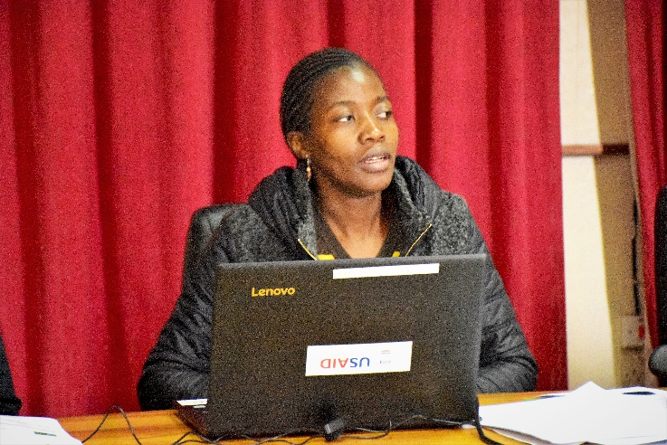
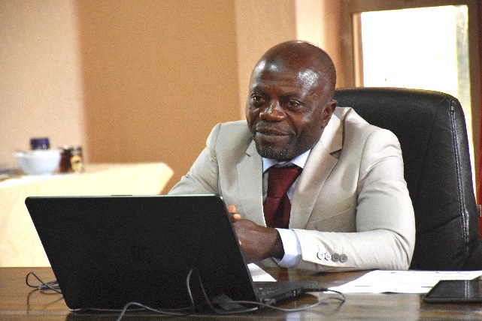
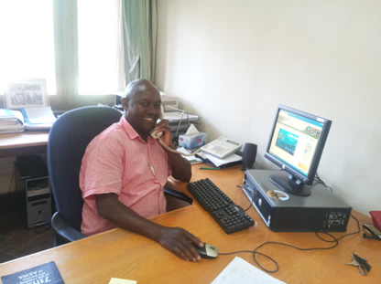
Project Team
Beatrice Khayota (PI)-NMK
James Mwangombe (Co-PI)-KFS
Benard Kamondo (CO-I)-KEFRI
Issa Katwesige (CO-PI)-Uganda
Joseph Otieno (CO-PI)-Tanzania
Agnes Lusweti (CO-I)-NMK
Jean Lagarde-Africa Coordinator
Solomon Kyalo (CO-I) KWS

Slide 4
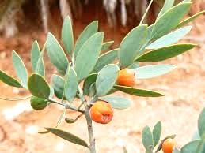
Background
East African Sandalwood (Osyris lanceolate) is a semi-parasitic evergreen tree
Occurs in arid and semi-arid habitats
Distributed in sub-Saharan Africa, from eastern to southern Africa
Traded internationally for its fragrance (oils and sawdust)
Also traded locally for timber, handcrafts and herbal medicine
Market uncoordinated, unstructured and unregulated
Eastern Africa population listed in Appendix II at CITES CoP 16 (Decisions 16.153 & 16.154)

Slide 5
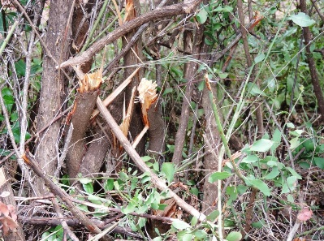
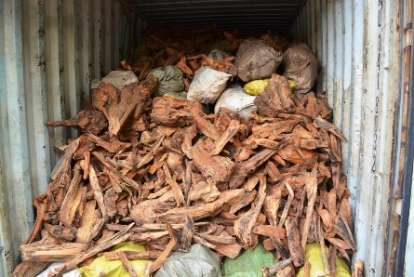
Justification
Osyris has entered the market as substitute for Santalum (Asian sandalwoods).
Harvested from the wild illegally and smuggled to international markets (high cases of seizures/confiscations)
Harvesting regime unsustainable (Whole stem, debarking and uprooting)-Declining wild populations/slow regeneration
High demand with attractive prices
Challenges with law enforcement in the region
Inadequate artificial propagation programs
Inadequate data on the status in the wild
Unsustainable Illegal harvesting
Seized shipment

Slide 6
Outputs
Specific Objective:
To assist the participating states (Kenya, Tanzania, Uganda) make relevant assessments for formulating NDFs of Osyris lanceolata
Output 1. Establishment of coordination team and relevant Committees of the project;
    Project inception for partner countries undertaken
    National Project launch in each partner country
    Coordination and relevant committees established
    Terms of Reference drafted for Committees

Slide 7
Outputs ctd.
Output 2. Status (research, management, ecological, and exploitable, control and monitoring, including ABS) of O. lanceolata in each country well established
  Terms of Reference for experts drafted and validated
  Discipline specific experts identified and subcontracted
  Final expert reports received, reviewed, validated and submitted
Output 3: Research relevant to management such as standing stock and quota setting for some selected sites well

Slide 8
Outputs ctd.
Conducting forest inventories, management measures, production with a view of establishing harvesting quota
    Field inventories completed
    Reports reviewed, validated for all the project partner countries submitted
Conducting a detailed study on production, harvesting, processing, transport, trade, control and monitoring of O. lanceolata with a view of establishing a fair tracking/control system.
    Field studies completed and draft NDFs prepared, reports validated for all the project partner countries and specific reports submitted

Slide 9
Outputs ctd.
Output 4: Mechanisms for Identification/verification and, traceability established
  Trainers identified and Terms of Reference drafted
  CTSP training course content developed and submitted
  Trainees from partner countries selected
  Venue and dates proposed, subject to the final disbursement of funds.
Output 5: Silviculture and domestication of O. Ianceolata well known
  Community awareness for Access and Benefit Sharing (ABS) and Participatory forest management workshops undertaken
  Training of trainer workshops, silviculture and domestication carried out in project partner countries

Slide 10
Outputs ctd.
Output 6: NDF report and realistic action plan well developed and implemented
  Further inputs are awaited, for drafting a realistic action plan for Osyris in all partner countries
Others:
  Documentaries on the status of O. lanceolata from respective countries completed and submitted

Slide 11
Outcomes
Knowledge has been generated on O. lanceolata in the partner countries and increased the national understanding of the species, through the different studies and trainings undertaken. This knowledge can be applied across the forest sector to improve science based decision making on other forest products.
Multi-stakeholder, inter-institutional and regional dialogues have occurred, that also aided project implementation.
The level of awareness about the project and Osyris lanceolata conservation was found to have increased, and the incidences of seizures at the borders have decreased.

Slide 12
Outcomes ctd.
The partners have enjoyed different levels of synergy and peer to peer learning. This was particularly useful in undertaking output 2 and 3, where each partner country shared prior experiences with the other partners.
It has also enhanced institutional/cross-boundary coordination and collaboration between government entities involved with interventions on Osyris, through information sharing and exchange of best practices.
More effort is required in protection of O. lanceolata within and outside protected areas as the inventory and NDF activities indicated, there was still a lot of poaching and smuggling taking place.
The information generated by the project has demonstrated the need for government agencies to allocate funding to support propagation in Forest Stations working with the Sandalwood, specifically for User Group under the Community Forest Association.

Slide 13
Outcomes ctd.
Knowledge sharing among participating countries is a value addition strategy to the implementation of the project.
The involvement of local communities in nursery projects has sensitized farmers on the importance and benefits of establishing nurseries at home. They have expressed the need to strengthen Community Based Forest Management in the forests within their village jurisdictions
Knowledge on the harvest source of raw materials from sister states in East Africa and transportation to the processing factories and ultimate export of Sandalwood semi-finished products overseas, is vital for regional control and monitoring for sustainability

Slide 14
Best practices
  Tripartite collaboration between the three countries lowered the learning curve for the countries where not much work has been done, such as, use of DNA in prosecuting CITES related crimes; nursery practices for multiplication of Osyris and information sharing on cross-border trade
  The in country project scientific committees contributed to effective institutional coordination
  It was apparent that projects involve and value contributions of all potential stakeholder right from the inception of the project. These are target communities at the grassroots and the government control agencies

Slide 15
Cahlllenges/Lessons learnt
Timelines
  There were noticeable limitations in time frames set aside to deliver on some rigorous activities such as inventories and domestication. The planned time frames are so limiting to allow for sufficient and satisfactorily work outputs. These can now be estimated with more confidence in subsequent phases or future projects of similar nature.
Budget
  The project was so ambitious compared to the available budget. However, qualified experts were hired as per the available resources, with support from the implementing agencies, by aligning as much as possible the project work with ongoing activities, to save on costs
  There was a lot of sacrifice or some level of complimentary voluntary contribution of time and skill by institutional experts, without which we would not have achieved as much as we did
  The project scope can be maintained as designed to inform a subsequent phase, but with adequate funds and timeframe

Slide 16
Challenges/Lessons learnt ctd.
Data
  On quantification of field stocks, the project was so ambitious compared to the available budget. Subsequently, the project partners scaled down field activities and assessed target populations, so as to have some data to consider
  The preliminary data collected from the field were inadequate to provide useful information on the distribution of O. lanceolata at national level.
  This advocates for more of similar studies for a broader picture of the available resource in the country
International Conventions
  Listing of Osyris lanceolata under CITES Appendix II and subsequent ban on harvesting and trade, has facilitated significant biomass recruitment and buildup.
  It is an opportunity to cascade CITES restriction into local legislation at different regulating bodies from the Central government, Game reserves, National Parks, Local government Authority and Village government

Slide 17
Challenges/Lessons learnt
Sustainable use
  The East African region has an opportunity to benefit from the Sandalwood legal trade, if sustainably managed. This can be successfully implemented through organized groups of farmers and private investors, as demonstrated in some partner countries.
Others
  Most significant, was the onset of COVID 19 pandemic, which was not even remotely anticipated and has been the most disruptive event to access to information, funds transfer, meetings and restrictive to any planned project activities. All project partner states were affected and had to proceed cautiously with implementation of activities.
  Electioneering periods in all partner countries disrupted implementation of certain activities to some extent.

Slide 18
Recommendations
Study Scope:
  There is need for a country wide inventory so as to provide data on the stocks in the country. This will also provide data that would enable prioritization of target sites based on stock and severity of threat.
  There is need to provide sufficient funds to complete outputs by engaging the best experts; prioritization of target sites based on stock and severity of threat.
  Given the nature of species involved, there is need for longer project periods to enable longer experiment time
  Projects should also cater for studies, including facilitating proposals on non CITES listed species but threatened by international trade
  There is need for project in-built communication, education and public awareness program.
Trade
  There is urgent need to determine current status of the species country wide through NDFs, for possible quota setting for sustainable local and international trade in the species.

Slide 19
Recommendations ctd.
Enforcement
  The study recorded unregulated trade of the sandalwood across the borders of East Africa states, yet there is inadequate tracking of the trade chain and quantities involved. This is a suggestive of lack of inter-regional surveillance and coordination. The region must expedite synchronization of available Acts and regulations for coordinated monitoring and control
  There is need for awareness creation among the forest managers and other law enforcement staff on the identification of wood from sandalwood. A number of them were duped into believing that it was just firewood letting consignments pass.
  Need to develop and deploy more efficient detection methods since mode of smuggling has changed with enhanced law enforcement, from transportation using large trucks to SUVs, small saloon cars, motorbikes and even being hidden among food stuffs on carriers of passenger vehicles

Slide 20
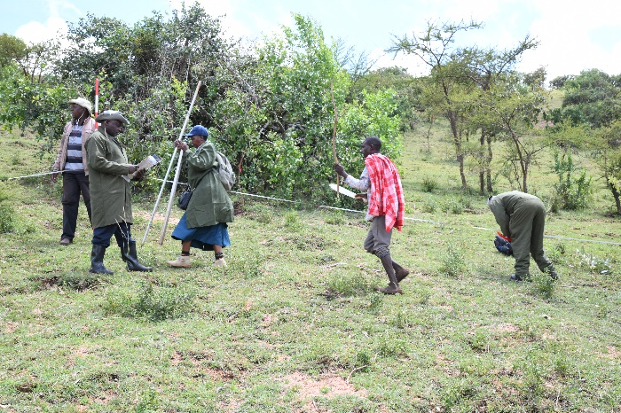
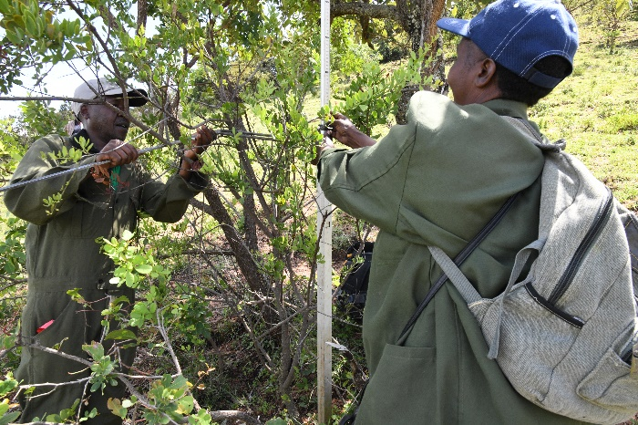
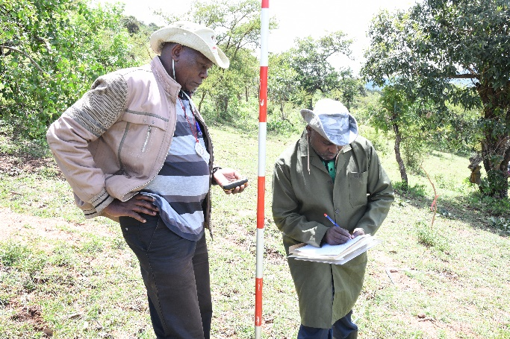
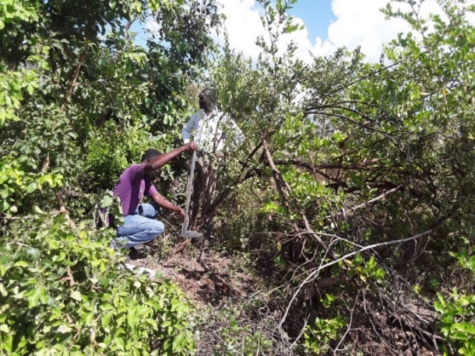
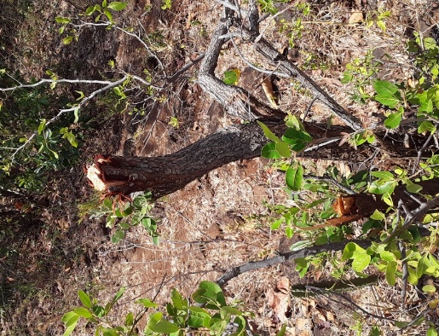
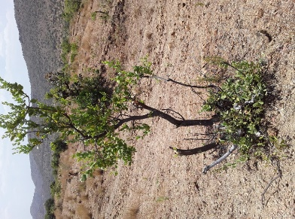
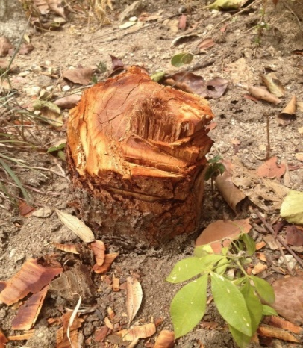
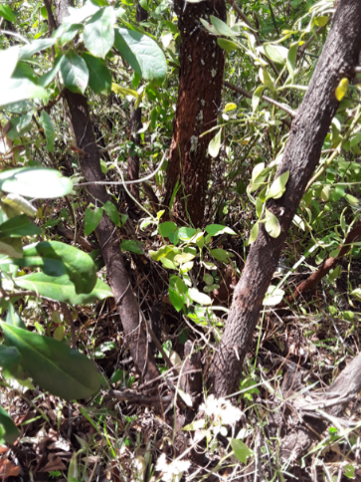
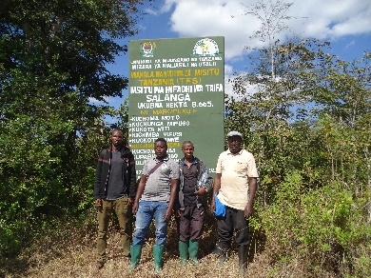
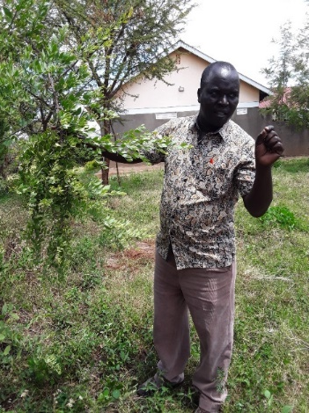
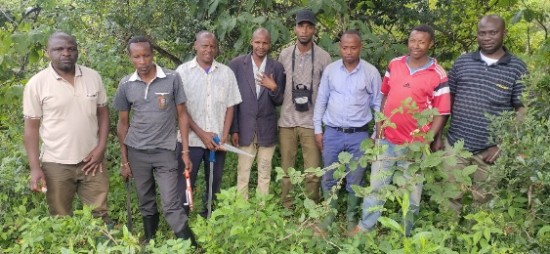
Photos

Slide 21
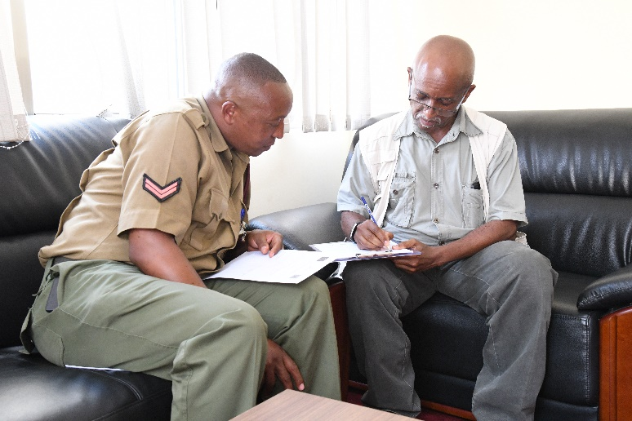
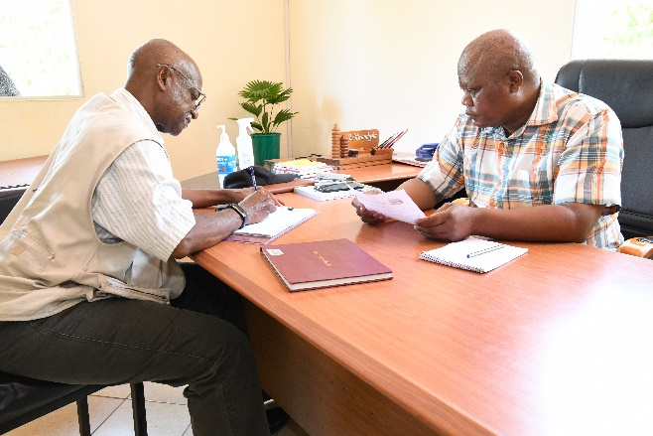
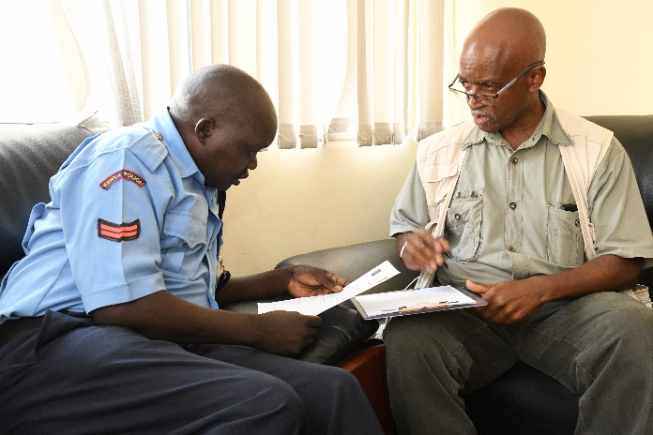
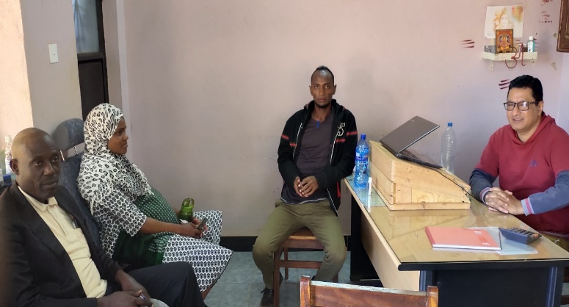
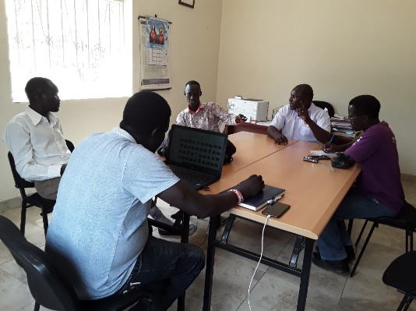
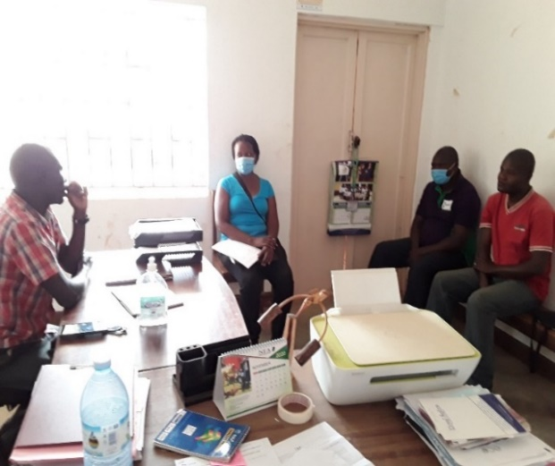
Photos

Slide 22
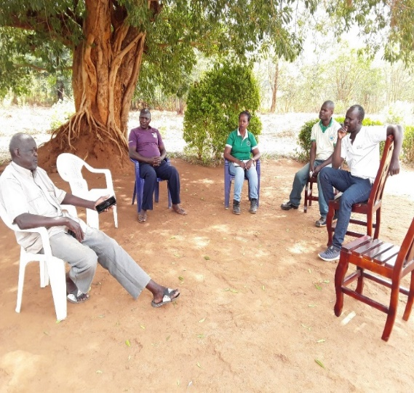
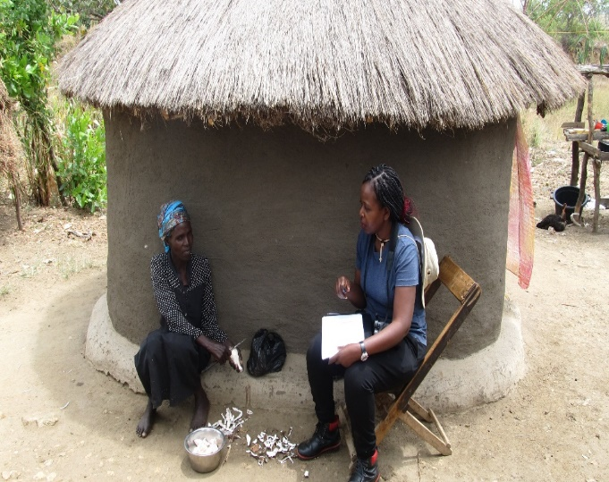
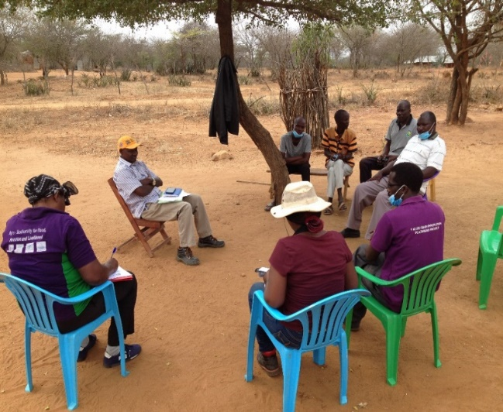
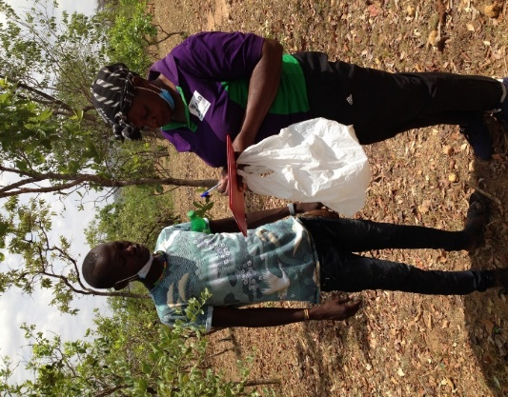
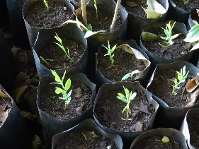
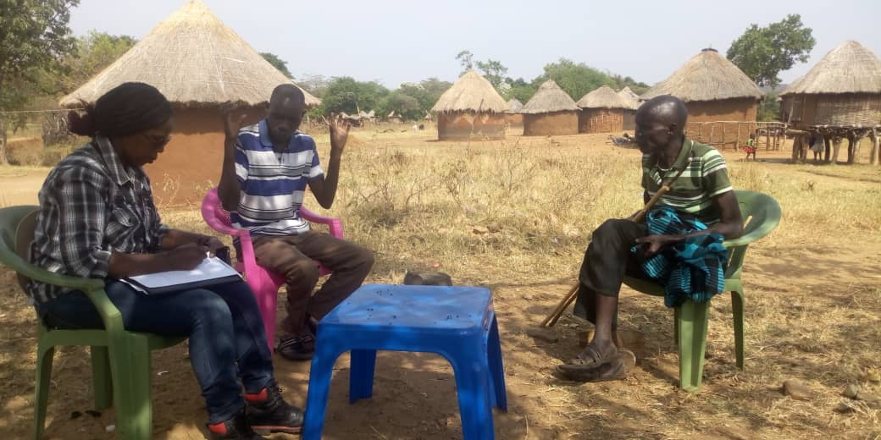
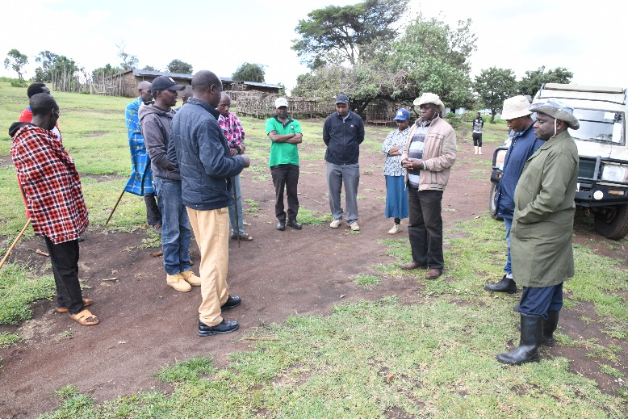
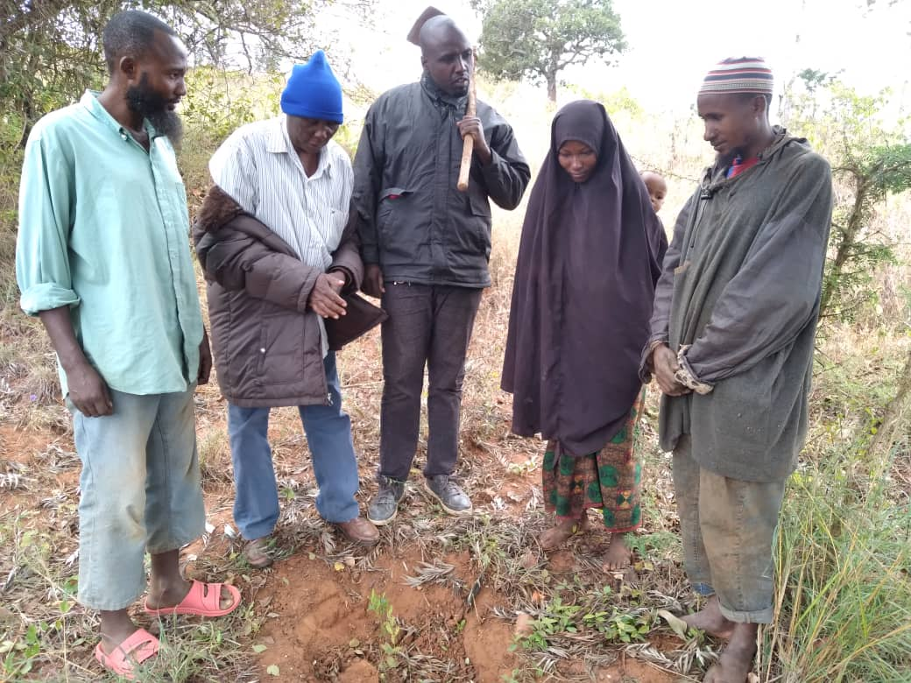
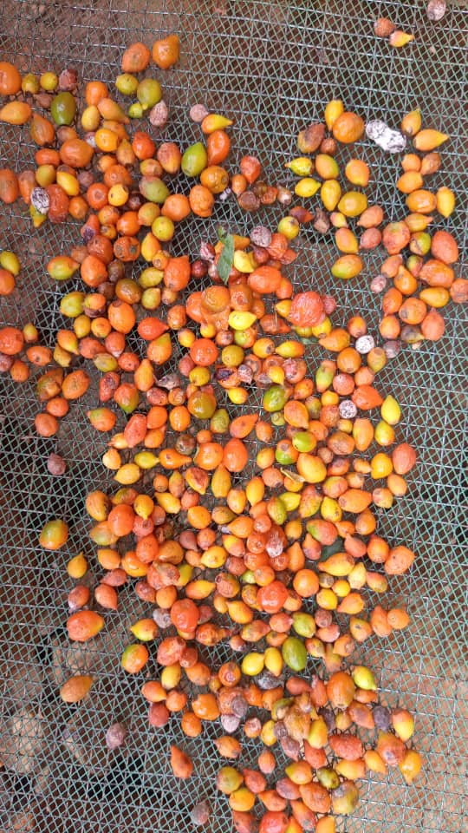
Photos ctd.

Slide 23





Acknowledgements
MINISTRY OF WATER AND ENVIRONMENT
Presenter: Dr. Beatrice Khayota
Email: bkhayota@museums.or.ke; bkhayota@hotmail.com

Slide 24
Thank you

