Slide 1




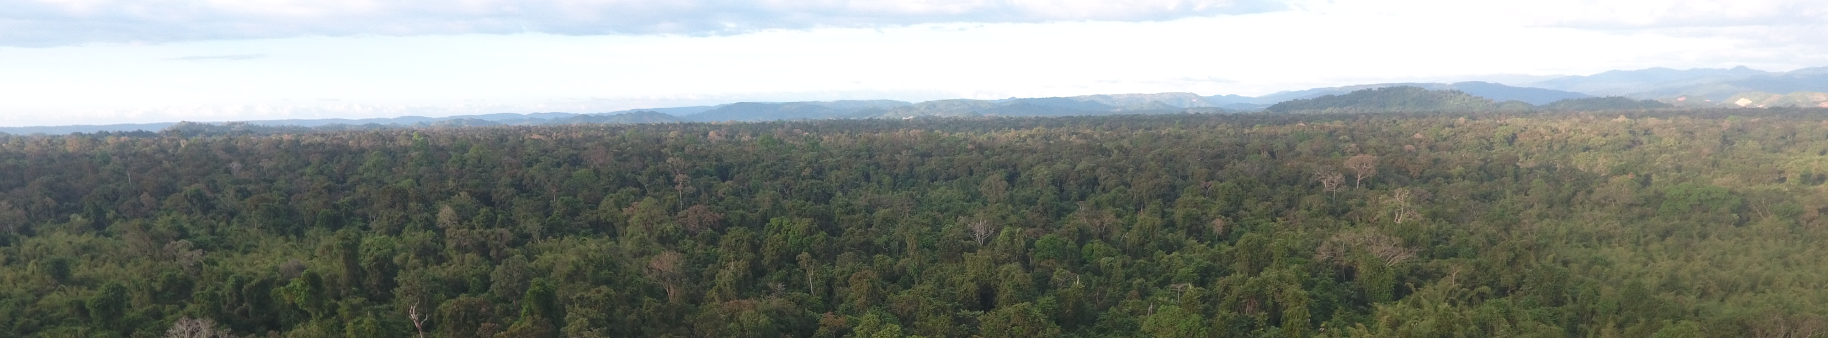
Strengthening the management and conservation of Dalbergia cochinchinensis and Dalbergia oliveri in Vietnam
Implemented by
Center for Nature Conservation and Development

Slide 2
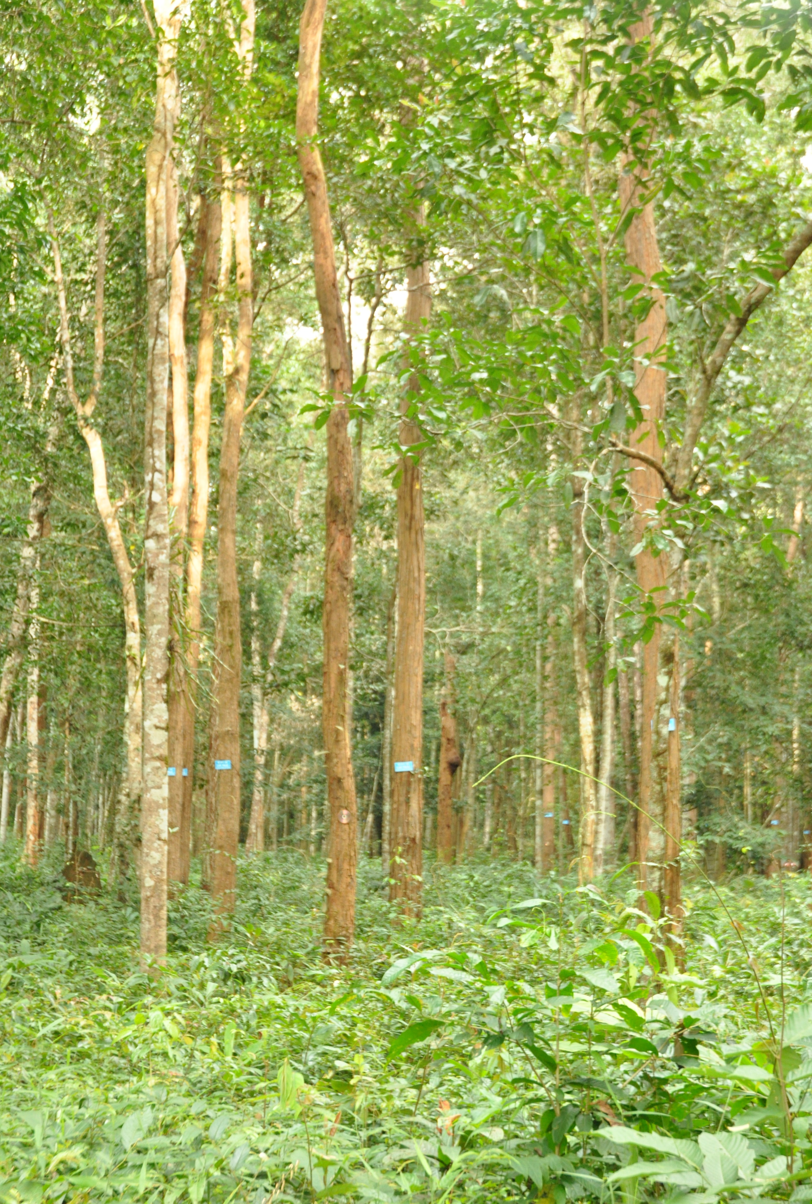
Project goal, objective and timeframe
Goal
To ensure long-term sustainable conservation and management of harvesting and trading rosewood species in Vietnam
Objective
To formulate a Non-detrimental findings, report and support the implementation for D. cochinchinensis and D. oliveri in Vietnam
To develop a long-term conservation plan for D. cochinchinensis and D. oliveri in Vietnam
To develop a rosewood identification manual to support identifying, tracking and managing of the harvest and trade more effectively
Time frame:
April 2019 – March 2021 – no-cost extension to September 2022

Slide 3
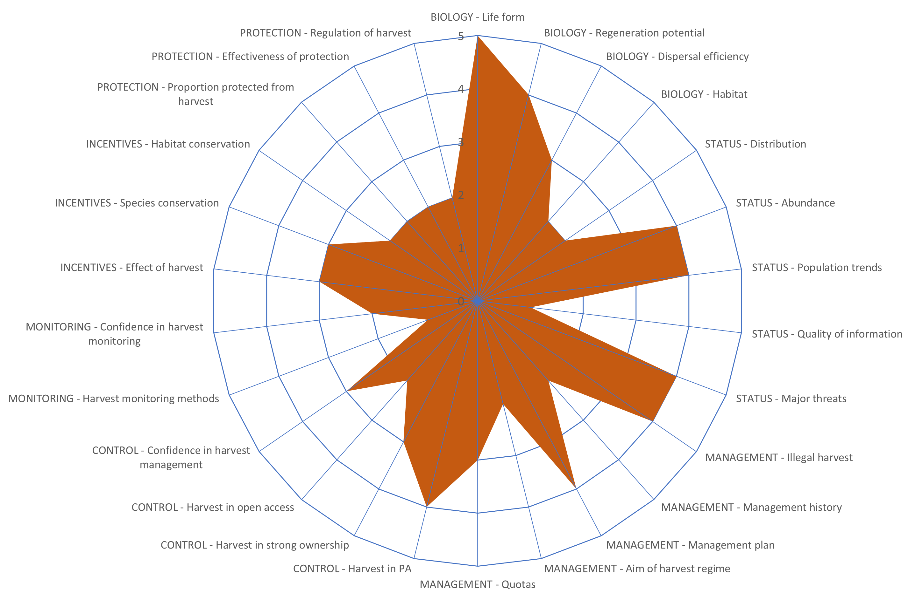
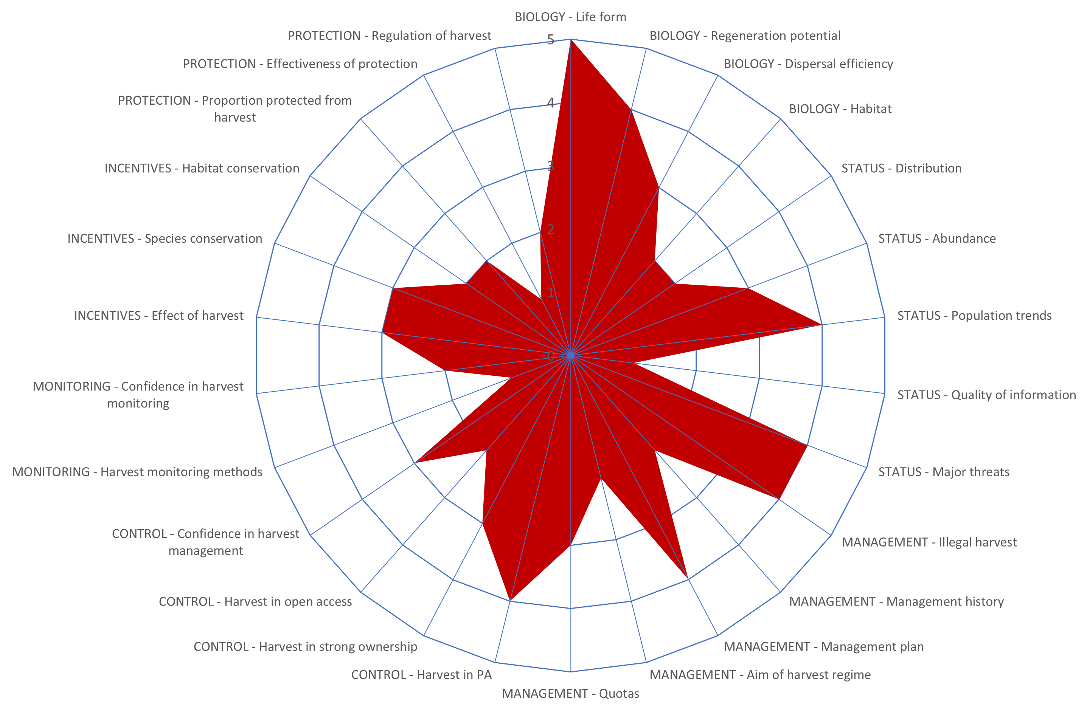
Key Outputs
A complete non-detrimental findings assessment for D. cochinchinensis and D. oliveri in Vietnam formulated
  Reviewed the taxonomy, biology, ecology, and the status, trend and population structure and dynamics of D. cochinchinensis and D. oliveri.
  Reviewed the current harvest control and monitoring of D. cochinchinensis and D. oliveri.
  Conducted spatial analysis to prepare distribution maps of D. cochinchinensis and D. oliveri.
  Assessed management practices and conservation status of D. cochinchinensis and D. oliveri.
  Conducted a systematic field survey on the population distribution, abundance, and stocking of D. cochinchinensis and D. Oliveri in key protected areas.
  Zero quotas for wild harvest rosewood from 2022-2027
  Strong recommendation for improving in-situ conservation
  and attention on recovery in known historical ranges.

Slide 4
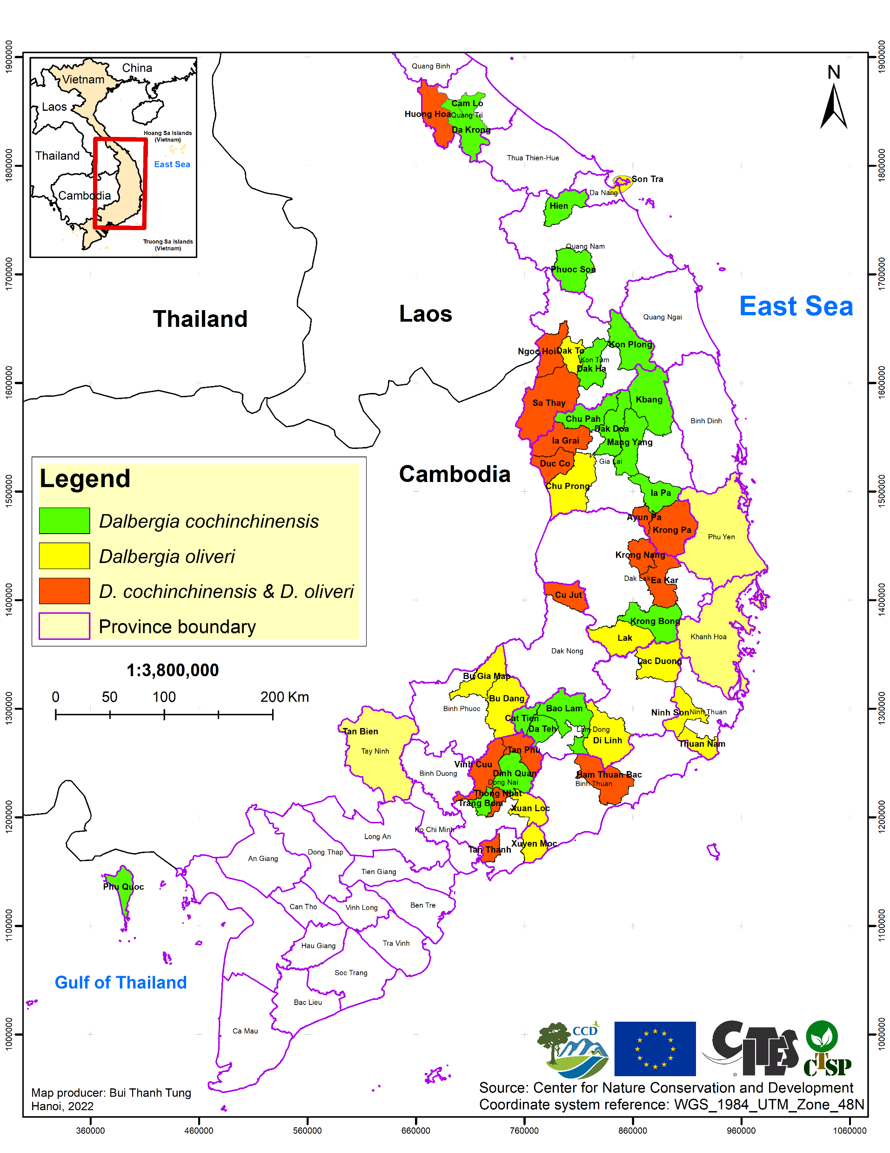
Key Outputs
A management and conservation plan for D. cochinchinensis and D. oliveri in Vietnam prepared and piloted
  Seven objectives, 12 outputs, and 38 activities
  Duration: from 2022 to 2035
  Strengthening the protection of the wild populations including all identified important conservation sites.
  Integrating rosewood replanting into annual indigenous tree planting programs and specific rosewood recovery planting programs in known-range areas.
  Piloted in the Yok Don national park and the Quang Tri province for D. cochinchinensis.
  Piloted in the Cat Tien and Bu Gia Map national parks for D. oliveri.

Slide 5
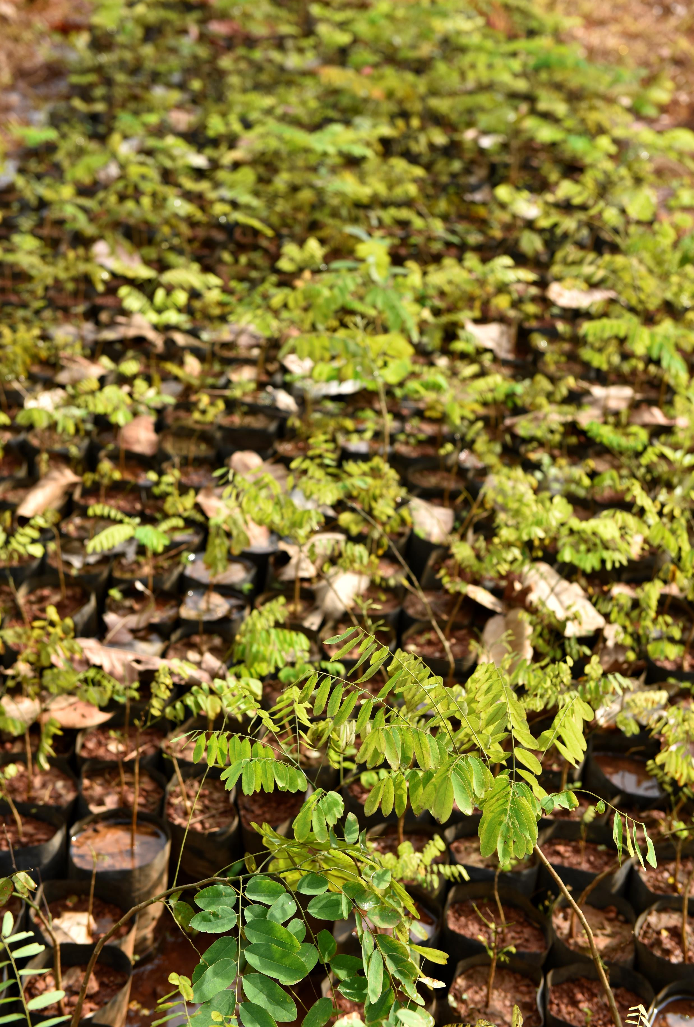
Key Outputs
A management and conservation plan for D. cochinchinensis and D. oliveri in Vietnam prepared and piloted (continued)
  What have we piloted in the Cat Tien national park, Yok Don national park and Quang Tri province.
    Identified mother trees and collected seeds
    Assisted nursery techniques (establishing the nursery, preparing the soil, treating and sowing seeds, tending after sowing, making pots and arranging seedbeds, growing seedlings into pots, and managing pests).
    Prepared rosewood monitoring and protection plan.
    2000 seedlings of D. oliveri were planted in 3 ha in Cat Tien NP.
    9000 seedlings of D. cochinchinensis to be planted in Quang Tri province from September 2022
    6000 seedings of D. cochinchinensis to be planted in Yok Don national park in 2023.

Slide 6
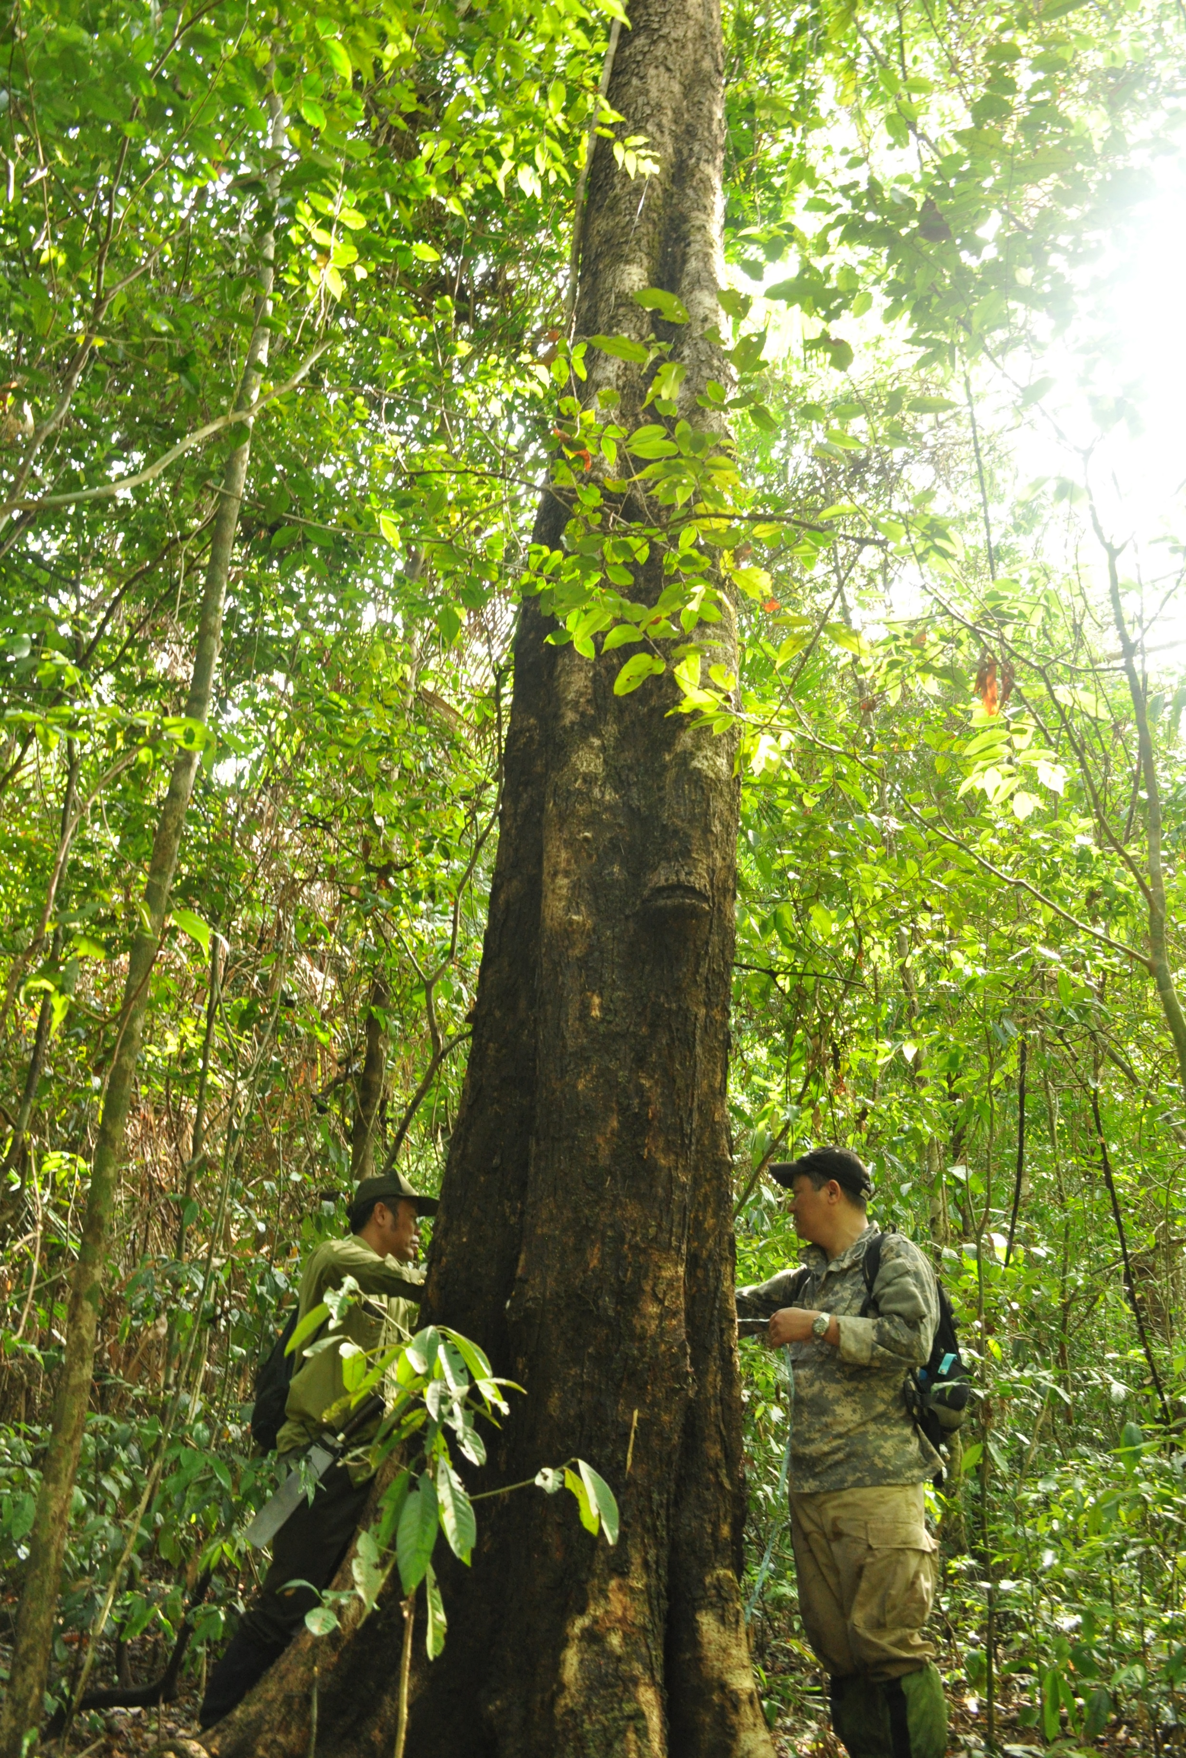
Key Outputs
Capacity of local authorities and management agencies improved
  Developed a rosewood identification manual to support management and enforcement
  Developed a Dalbergia ID App for mobile devices to assist in the identification of samples in the field.
  Organized technical discussions and workshops on distribution maps, NDF report, and management plan to discuss and finalize the documents.
  Provided training on the use of the identification manual and ID App.
  Provided a training course on NDF’s recommendations.
  Provided a training course on management and conservation plan.
  Shared lessons learnt on piloting the implementation of the conservation and management plan to relevant stakeholders.

Slide 7
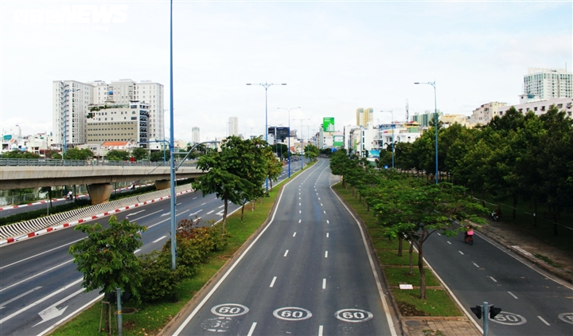
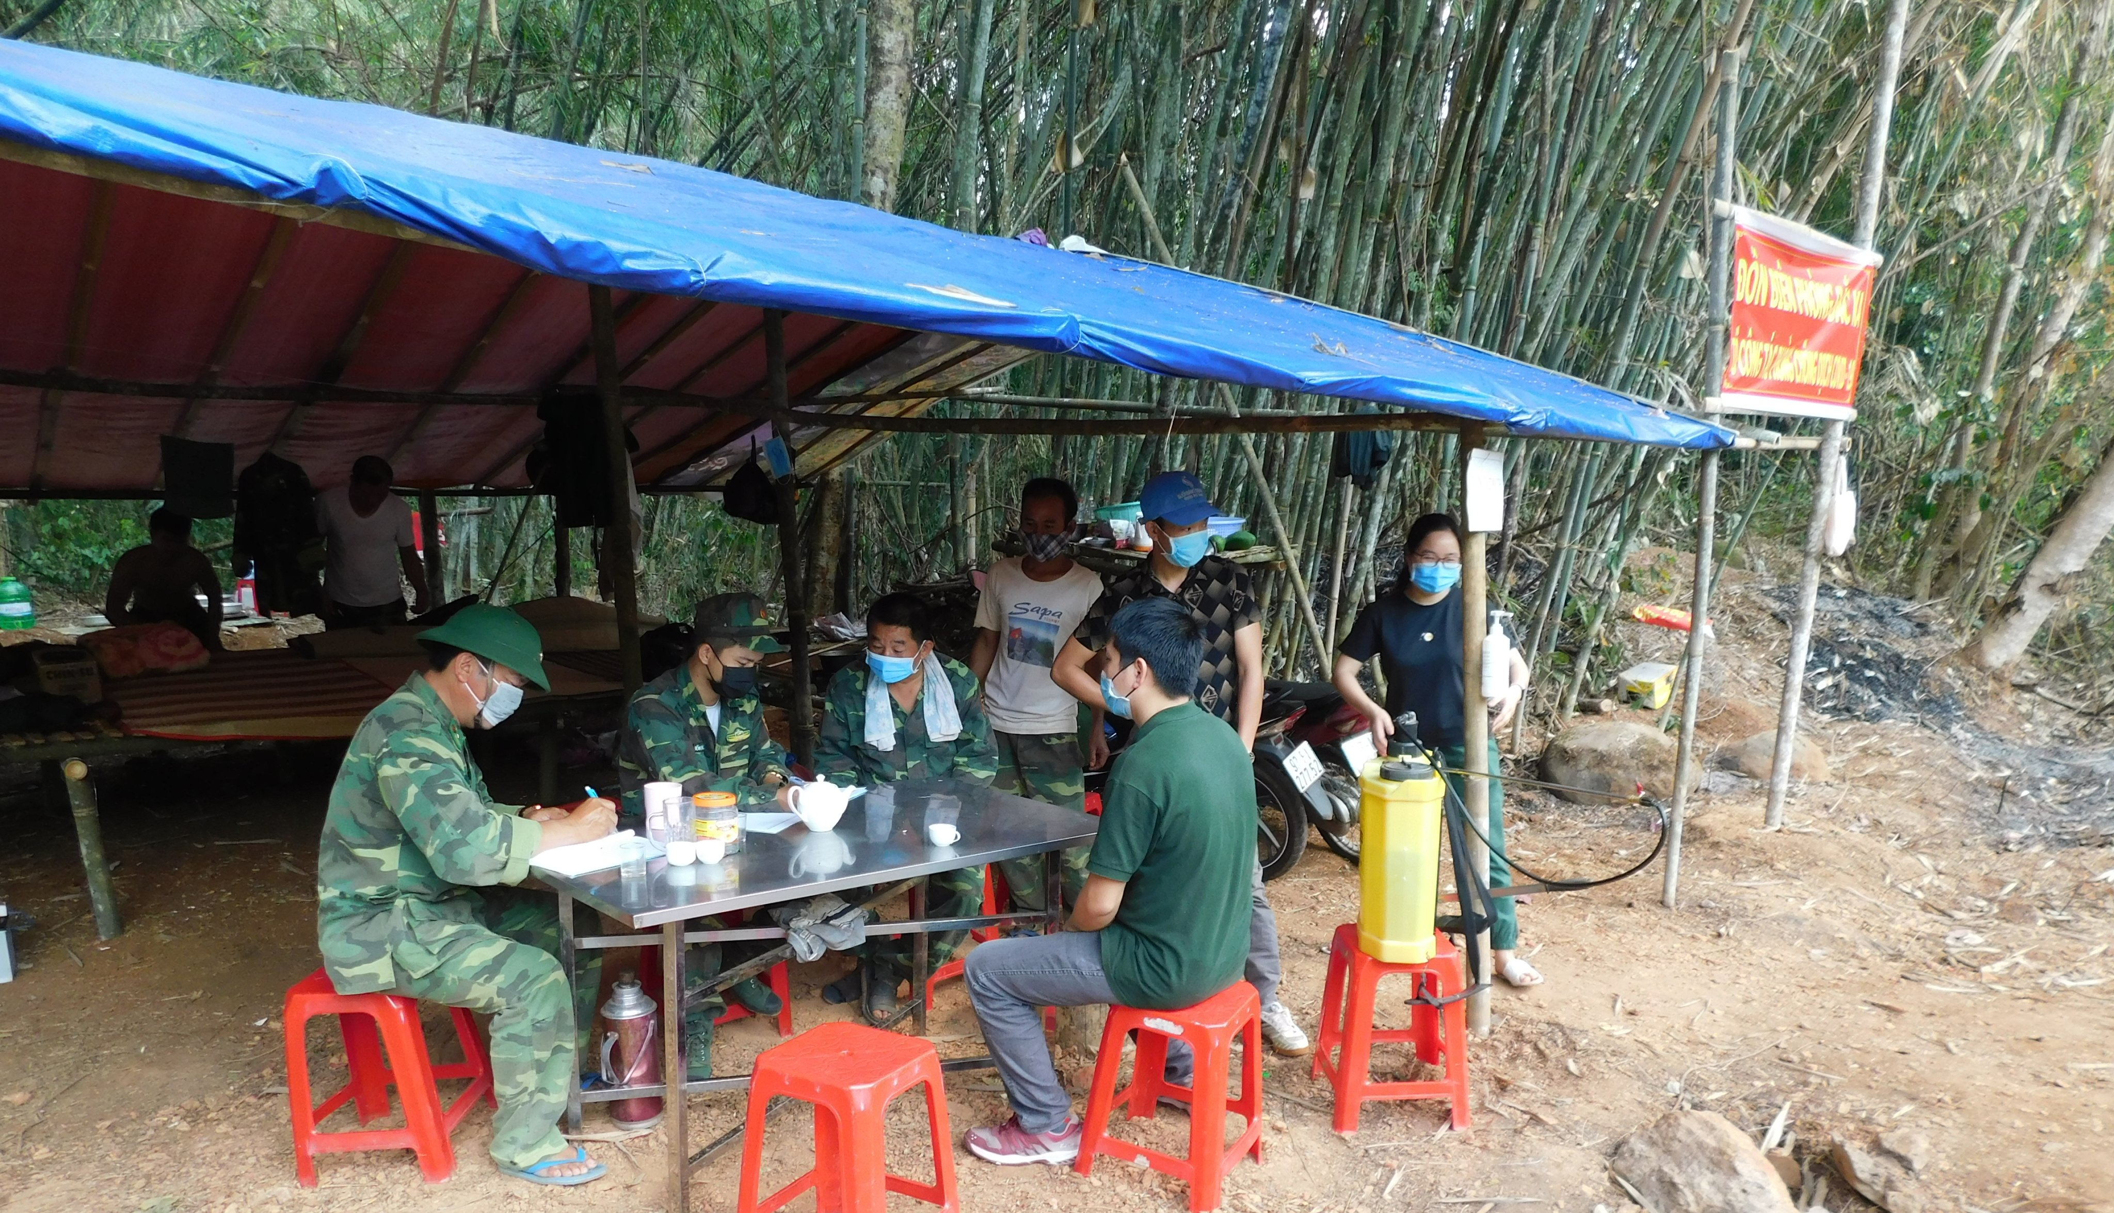
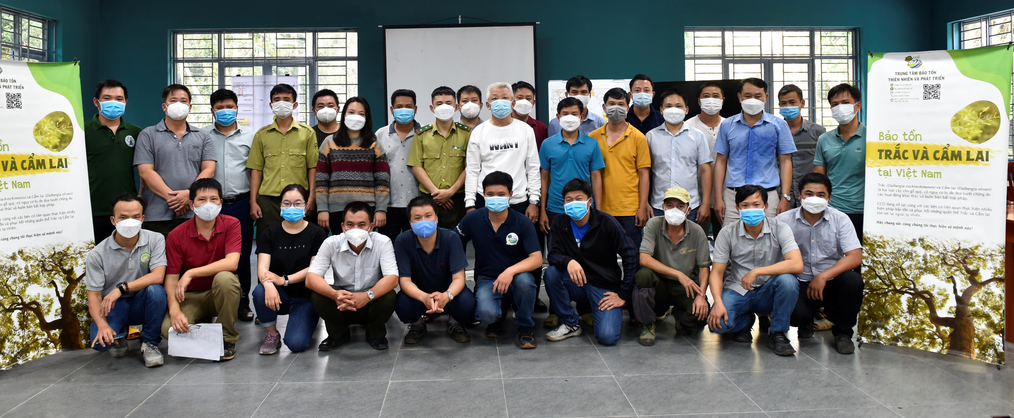
Difficulties and challenges encountered
Covid-19
  Prolong implementation
  Limit interaction with local stakeholders
Administrative process
  Long finance process
  Long extension process (no-cost extension because of covid-19)
Recommendation
  Support Vietnam to piloting conservation planting
  Include rosewood in list of indigenous tree that will be used in national reforestation program
  Pilot barcoding, block-coding to improve tracking of origin for trade management

Slide 8
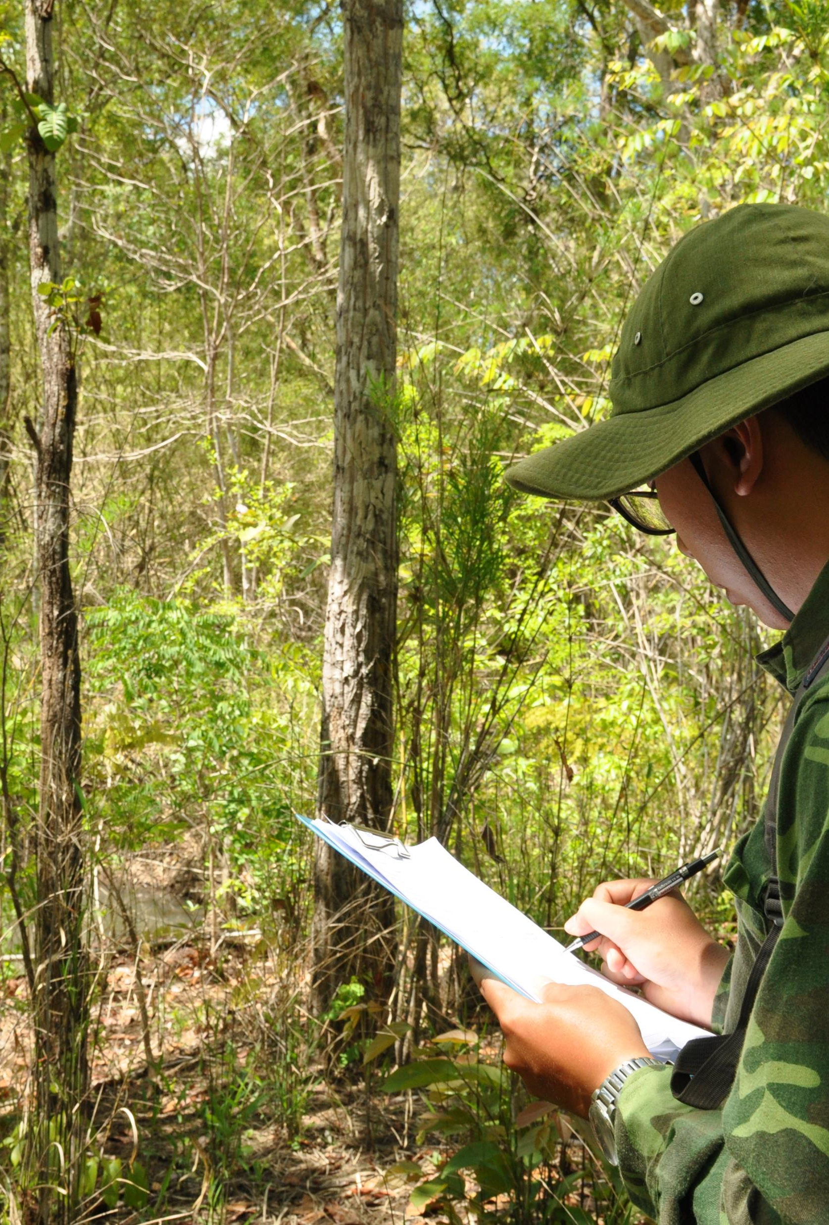
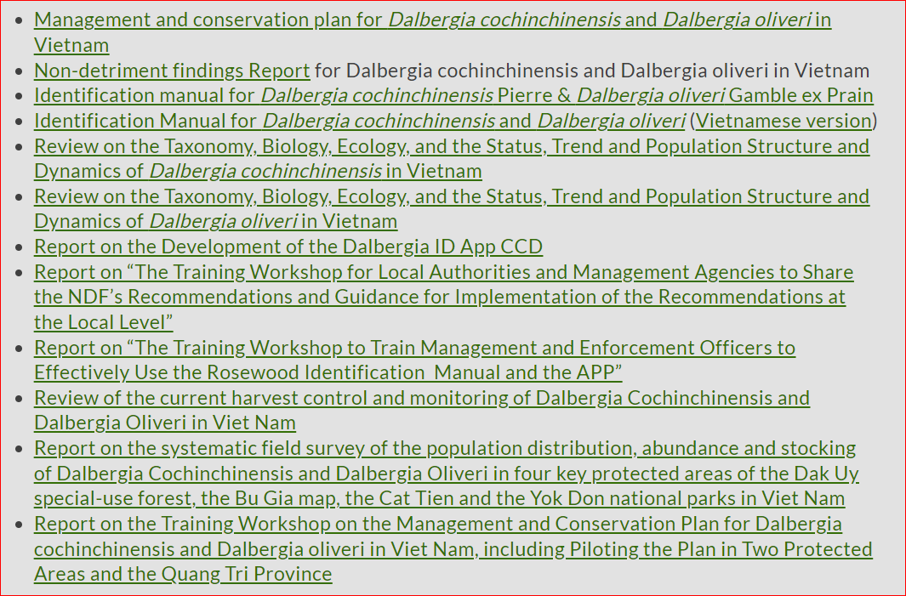
Published products
https://cites-tsp.org/regions/vietnam/

Slide 9
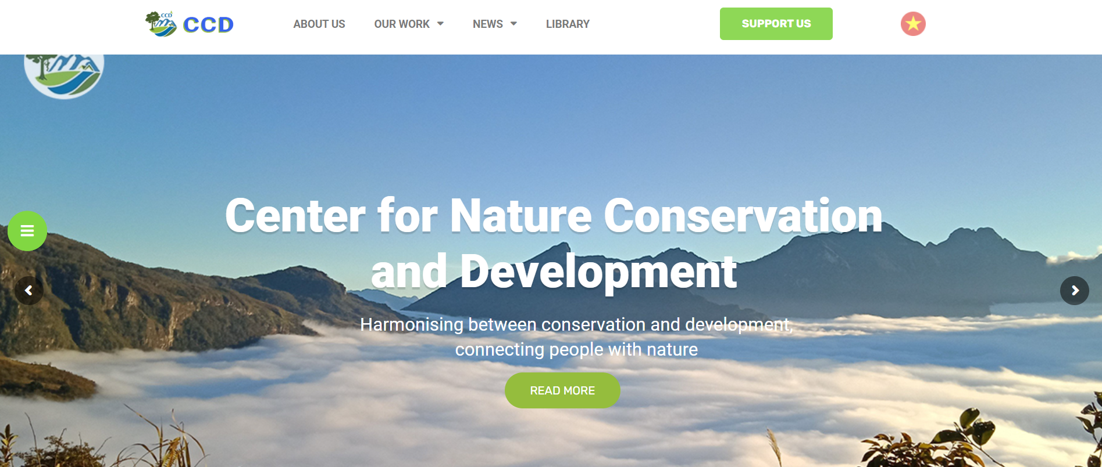
Thank you !
Visit and contact us at:
  https://ccd.org.vn/en/
  https://www.facebook.com/ccd.org.vn

